Slide 1

California School Climate, Health, and Learning Surveys (CalSCHLS): Progress Update
September 18, 2020
Note: The research reported here was supported by the Institute of Education Sciences, U.S. Department of Education, through Grant R305E150006 to the Regents of the University of California. The opinions expressed are those of the authors alone and do not represent views of the Institute or the U.S. Department of Education, or of the agencies providing data.

Slide 2
Question Consistency: Parent Survey
This school...
9. promotes academic success for all students.
Consistent in 1819, 1718, 1617, 1516
Same question is Q7 in 1415
15. provides quality counseling or other ways to help students with social or emotional needs.
Consistent in 1819, 1718, 1617, 1516
Same question in 1415 is Q13
16. is a supportive and inviting place for students to learn.
Consistent in 1819, 1718
Slight wording change in 1617, 1516, 1415: “is an inviting place for students to learn”. In 1415 it is Q14

Slide 3
Question Consistency: Parent Survey
17. allows input and welcomes parents’ contributions
Consistent in 1819, 1718, 1617, 1516
Same question is Q15 in 1415
27. encourages me to be an active partner with the school in educating my child
Consistent in 1819, 1718, 1617, 1516
Same question is Q26 in 1415
30. provides high quality instruction to my child.
Consistent in 1819, 1718
Same question is Q40 in 1617
Not included in 1516, 1415

Slide 4
Question Consistency: Parent Survey
31. motivates students to learn.
Consistent in 1819, 1718,
Same question is Q41 in 1617,
Same question is Q40 in 1516
Same question is Q39 in 1415
32. has teachers who go out of their way to help students.
Consistent in 1819, 1718,
Not included in 1617, 1516, 1415
33. has adults who really care about students.
Consistent in 1819, 1718
Same question is Q43 in 1617
Same question is Q42 in 1516
Same question is Q41 in 1415

Slide 5
Question Consistency: Parent Survey
34. has high expectations for all students.
Consistent in 1819, 1718
Same question is Q44 in 1617
Not included in 1516, 1415
How well has this child's school been doing the following things during the school year?
64. Providing information on how to help your child plan for college or vocational school.
Consistent in 1819, 1718
Same question is Q62 in 1617
Same question is Q58 in 1516
Not included in 1415

Slide 6
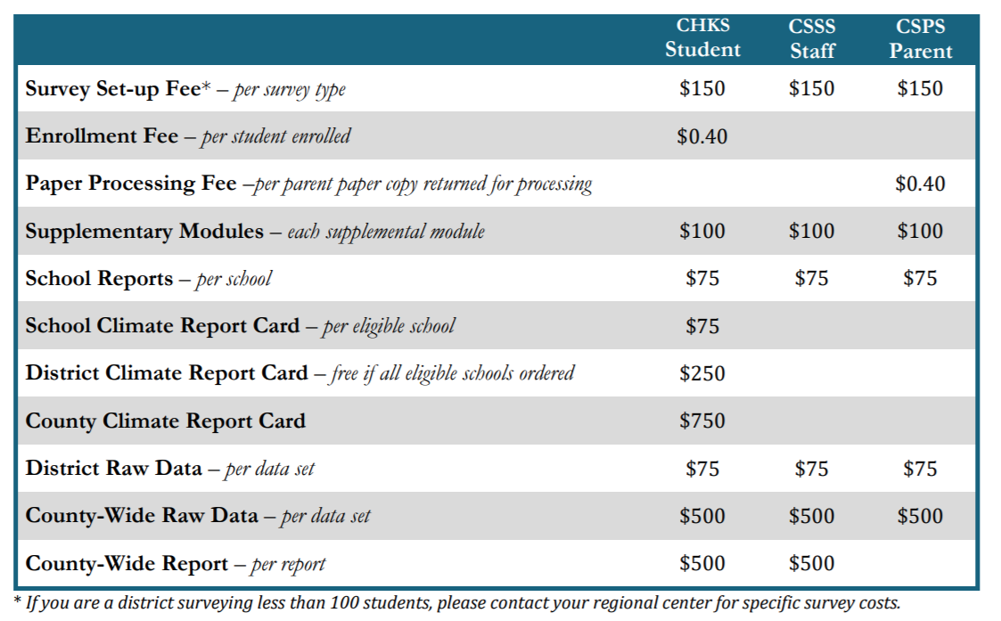
Subsidized Fee Schedule for Schools

Slide 7
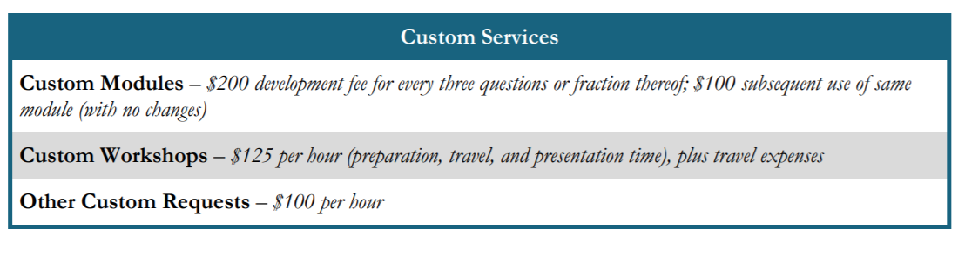
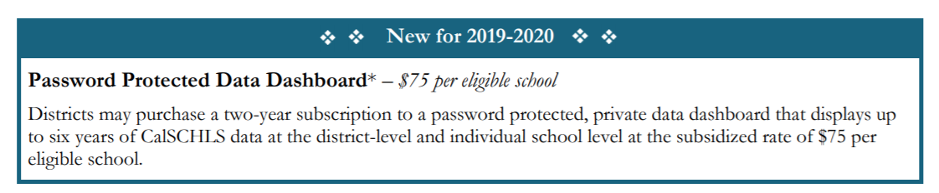
Subsidized Fee Schedule for Schools

Slide 8
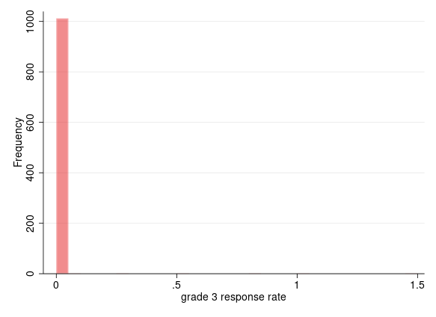
Survey Response Rate: Elementary

Slide 9
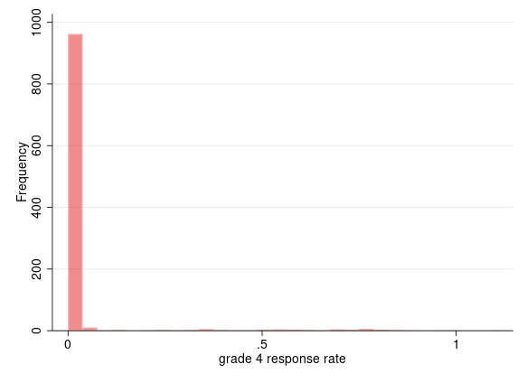
Survey Response Rate: Elementary

Slide 10
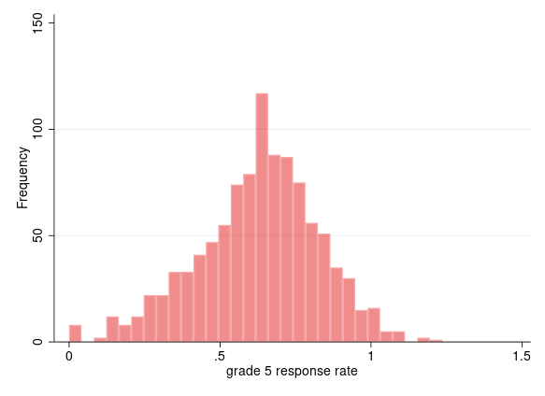
Survey Response Rate: Elementary

Slide 11
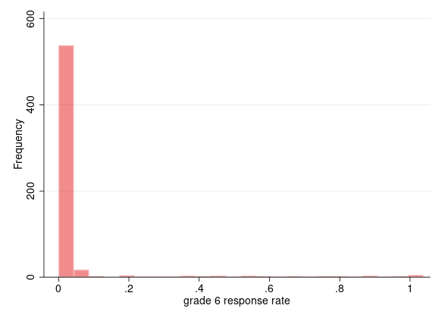
Survey Response Rate: Elementary

Slide 12
Problem
Several instances of response rate > 1
1 instance each in grade 3 and 4
18 instances in grade 5
1 instance in grade 6
Enrollment figures collected on the census date which is normally on or around Oct 1, is it possible there are other students who enroll after that date?

Slide 13
What else?
Created percentage of female and male respondents in each grade, can compare with demographics in enrollment figures
As well as percentage of respondents by ethnicity in each grade for secondary survey
What metrics do we use for comparing demographics in survey sample and demographics in enrollment figures?

Slide 14
Work in Progress
Survey response rate investigation

Slide 15
Thank you!
California Department of Education
Jonathan Isler
Ryan Fuller
California Community Colleges Chancellor’s Office
Gary Adams
Todd Hoig
California State University Chancellor’s Office
Ed Sullivan
Matthew Case
Note: The research reported here was supported by the Institute of Education Sciences, U.S. Department of Education, through Grant R305H150073 to the Regents of the University of California. The opinions expressed are those of the authors and do not represent views of the Institute or the U.S. Department of Education, or of the agencies providing data.

